Slide 1
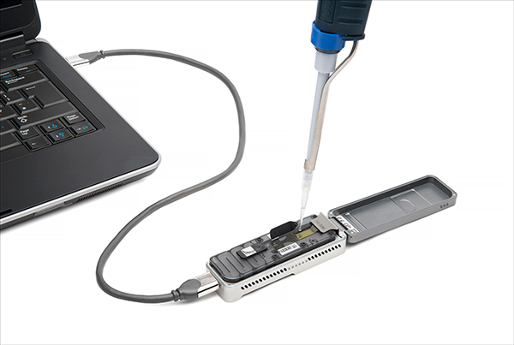

FastReport

Slide 2
2
Project timeline
Weeks | Task
Week 1 | Discuss the overview of project and planning
Week 2 | Main Function | Feature 1 | Review + Feedback
Week 3 | Feature 2 | Feature 3 | Review + Feedback
Week 4 | Feature 4 | Feature 5 | Review + Feedback
Week 5 | Improvement Discussion |  | Review + Feedback
Week 6 | Program testing and preparation of presentation

Slide 3


3
Team collaboration
Zoom meeting
Storyboarding agile

Slide 4
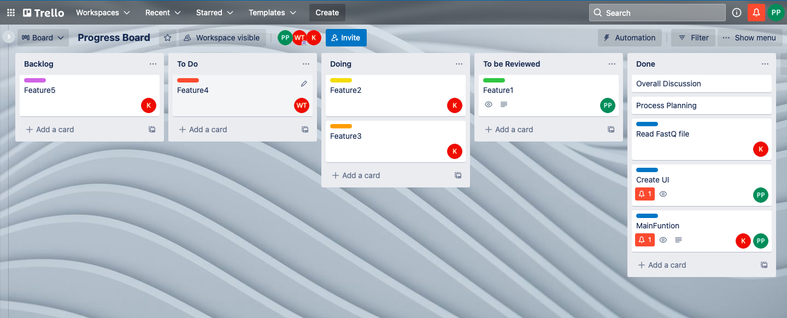
4
Storyboarding Agile

Slide 5
5
Challenges
Stuck in some features
Code debugging
Solutions
Study example code on the internet
Sharing the problem with teammate to find a solution
Using GitHub

Slide 6
Overview of Feature
6
Toggle Filtering Result based on Barcode and Pass Read
Basecalled summary table
Number of reads per barcode
Basecalled reads length
Basecalled reads PHRED quality
Basecalled reads length vs PHRED quality score
Notes:
123

Slide 7
Program
7
Download
Direct: https://github.com/Gummyyy/SIRE504-Term_Project
Clone: git clone https://github.com/Gummyyy/SIRE504-Term_Project.git
Install
pip install -r requirements.txt
Run
./FastReport QuickHTML -f filename.fastq
Notes:
123

Slide 8
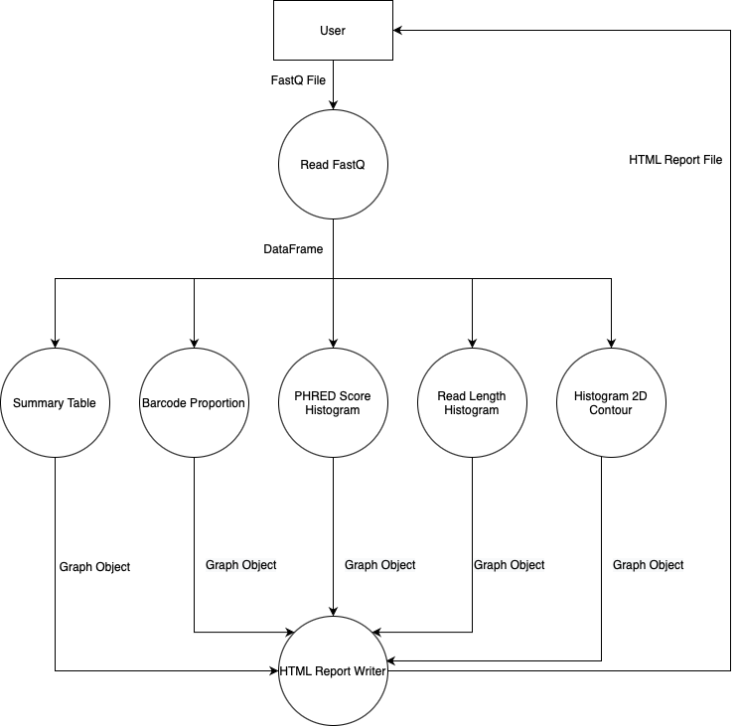
Program’s information flow
8
Notes:
123

Slide 9
0. FastQ to DataFrame
9
Input: FastQ file
Output: DataFrame
Process:
Read fastq file by seq.io lib
Use regex to extract each values from each row
Assign each variable to each list
Construct DataFrame from all list
Return DataFrame

Slide 10
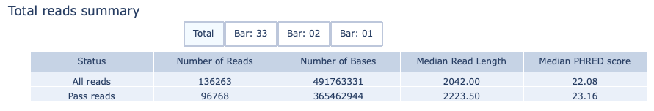
Basecalled Summary table
10
Input: DataFrame
Output: Graph object
Process:
filter pass read & barcode
calculate data in table
assign data into row and column in the table
apply all table to graph object
create buttons
add buttons to graph object and return

Slide 11
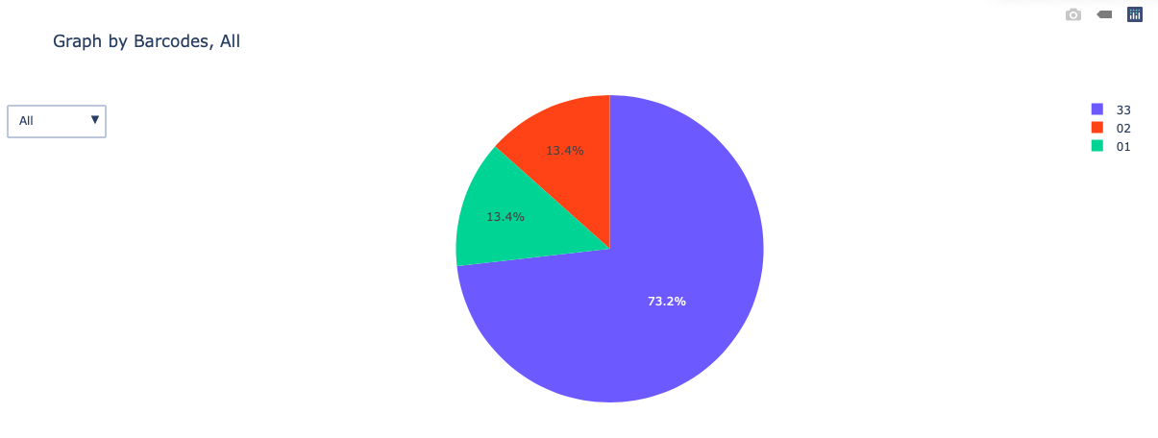
11
2. Number of reads per barcode
Input: DataFrame
Output: Graph object
Process:
1.filter pass read & barcode
2.create each filtered graph and add to trace list
3.add graph name to name list
4.apply all list to graph object and return

Slide 12
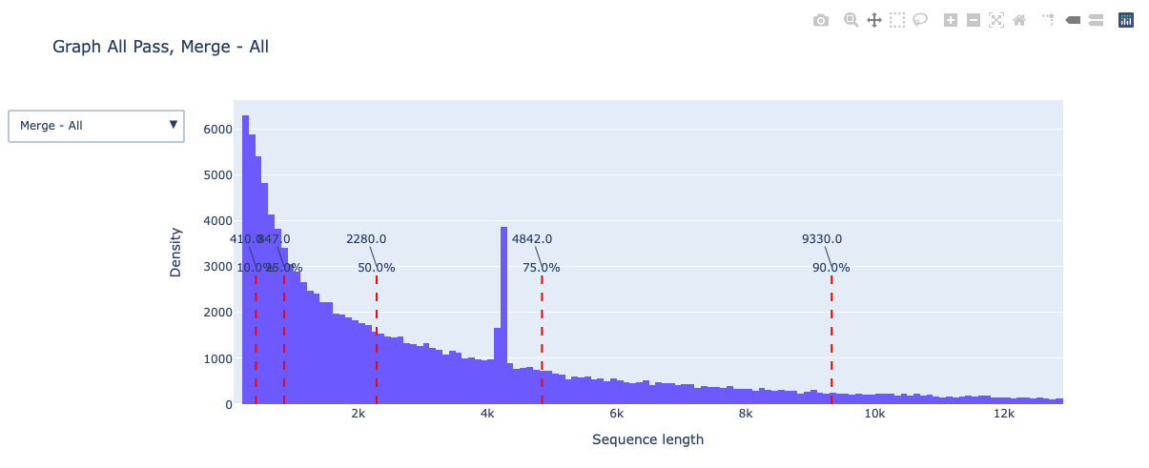
3. Basecalled reads length
12
Input: DataFrame
Output: Graph object
Process:
1.filter pass read & barcode
2.create each filtered graph and add to trace list
3.calculate percentile and keep as list
4.add graph name to name list
5.apply all list to graph object and return

Slide 13
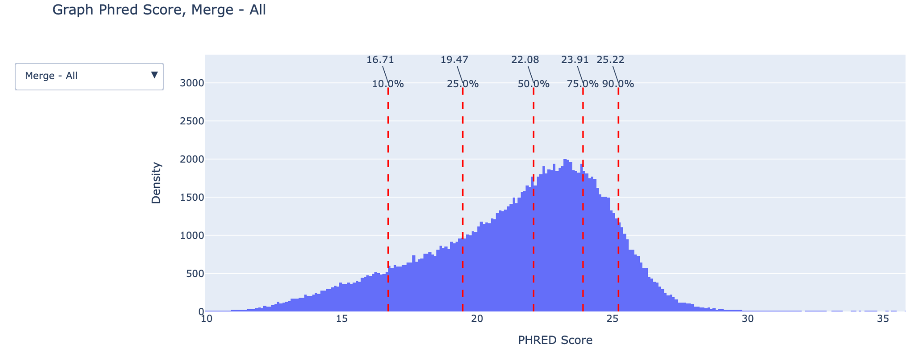
4. Basecalled reads PHRED quality
13
Input: DataFrame
Output: Graph object
Process:
1.filter pass read & barcode
2.create each filtered graph and add to trace list
3.calculate percentile and keep as list
4.add graph name to name list
5.apply all list to graph object and return

Slide 14
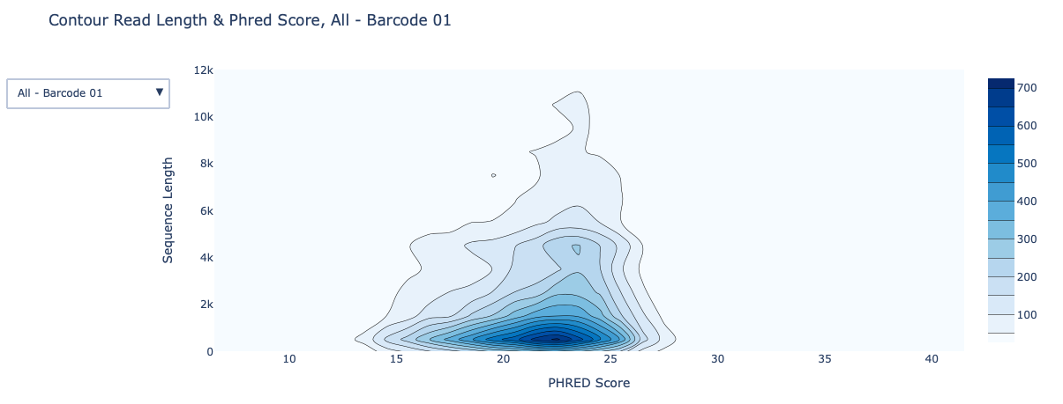
5. Basecalled reads length vs PHRED quality score
14
Input: DataFrame
Output: Graph object
Process:
1.filter pass read & barcode
2.create each filtered graph and add to trace list
3.add graph name to name list
4.apply all list to graph object and return

Slide 15
5. HTML Writer
15
Input: Graph object
Output: HTML file
Process:
1.Receive all graph object from plot function
2.Open file stream to write HTML file
3.Convert graph object to div output and add to HTML
4.Close file writer

